Slide 1
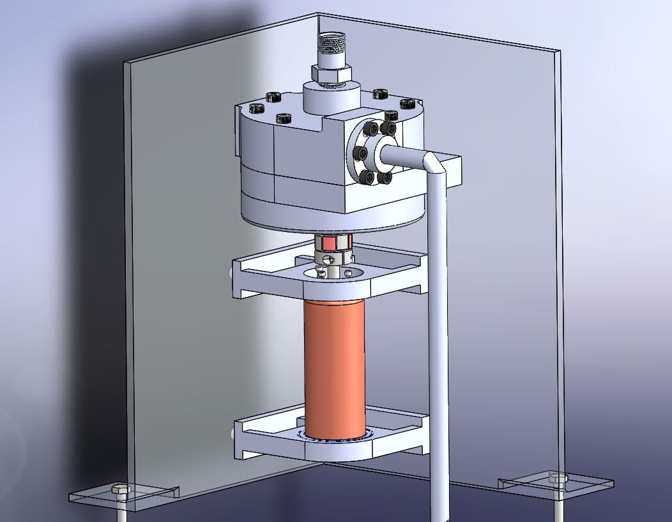

ELECTRIC FEED SYSTEM
FLIGHT-READY
ELECTRIC FEED
SYSTEM
TEAM 3
Julio Garcia
Philip Wahl
Jonas Mendoza
Nick Sheldon
Shayli Elrod
Hengrui Ju

Slide 2
AGENDA
ELECTRIC FEED SYSTEM
Project Proposal
Customer/Engineering Requirements
Progress on Design
Gantt Chart
Ongoing Projects
Technical Writing Tips
Recap

Slide 3
PSAS has requested an Electric Feed System to pump two liquid propellants into the engine of their upcoming Launch Vehicle 4 to participate in the Base11 space challenge.
ELECTRIC FEED SYSTEM
PROPOSAL
Sponsor: Portland State Aerospace Society
Project Title: Flight-Ready Electric Feed System

Slide 4
ELECTRIC FEED SYSTEM
REQUIREMENTS
CUSTOMER
REQUIREMENT | Priority
Must be tested with LN2 and IPA | 5
Must safely keep the propellants separated at all times | 5
Should have embedded sensors for data collection | 5
Should have emergency shut off procedure and battery cutoff | 5
Control system should use sensor data | 4
Input pressure 45-100 PSI, Output pressure 450 PSI. | 4
Must be compatible with liquid oxygen (LOX) | 3

Slide 5
ELECTRIC FEED SYSTEM
REQUIREMENTS
ENGINEERING
REQUIREMENTS | UNIT | ORIGINAL VALUE | UPDATED VALUE
PRESSURE | PSI | 400 | 450
MASS FLOW | lbm/s | 2.04 | 2.04
TOTAL SHAFT POWER | kW | 5.00 | 5.00
IPA ROTATIONAL SPEED | RPM | 20k | 35.6k
LN2 ROTATIONAL SPEED | RPM | 15k | 24.4k
ENGINE THRUST | kN | 2.2 | 2.2
MODULE DIAMETER | in | 12 | 12

Slide 6
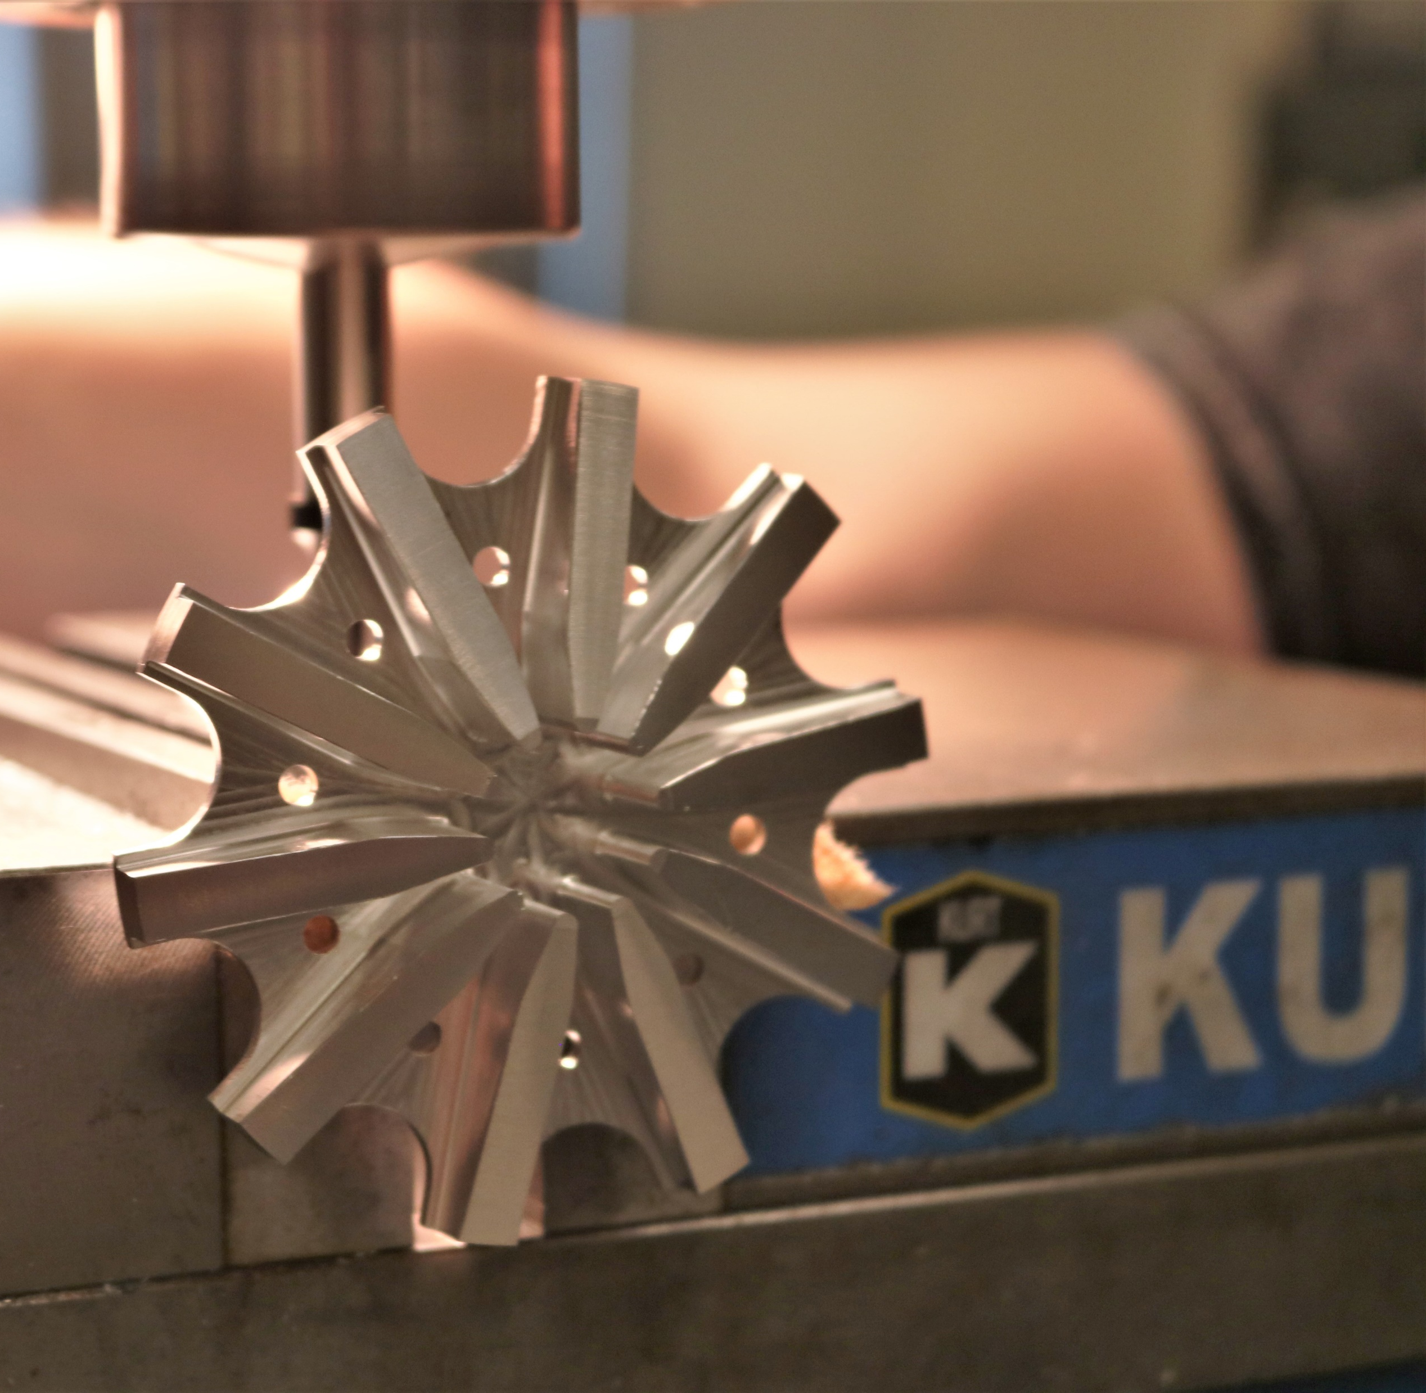
ELECTRIC FEED SYSTEM
IMPELLER MACHINING
6061 Aluminum Prototype
Single Piece Design
CNC Lathe & CNC Mill
Final Iteration Coming Soon
PROGRESS ON DESIGN

Slide 7
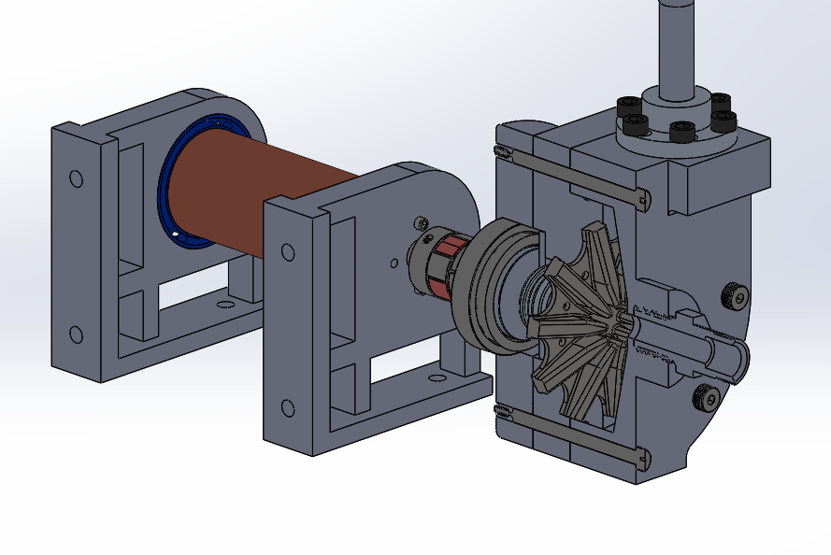
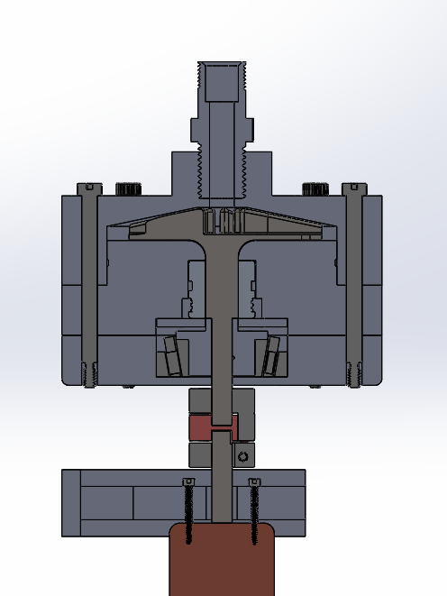
ELECTRIC FEED SYSTEM
PROGRESS ON DESIGN
IPA Pump: Final Design

Slide 8
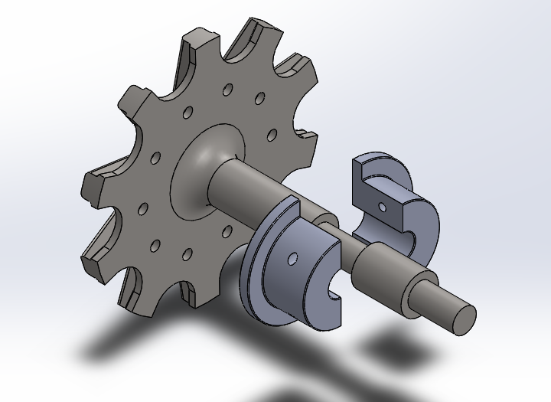
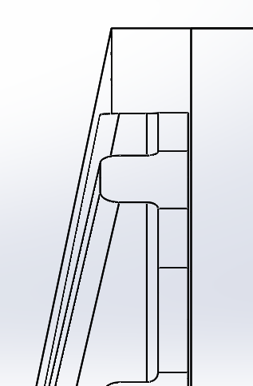
ELECTRIC FEED SYSTEM
PROGRESS ON DESIGN
IPA Pump: Final Design
Combined impeller shaft design required z-axis restriction
Axially split collar solves issue with simple assembly
Safety measure to protect impeller face from impact in case of failure
0.008in

Slide 9
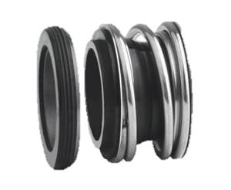
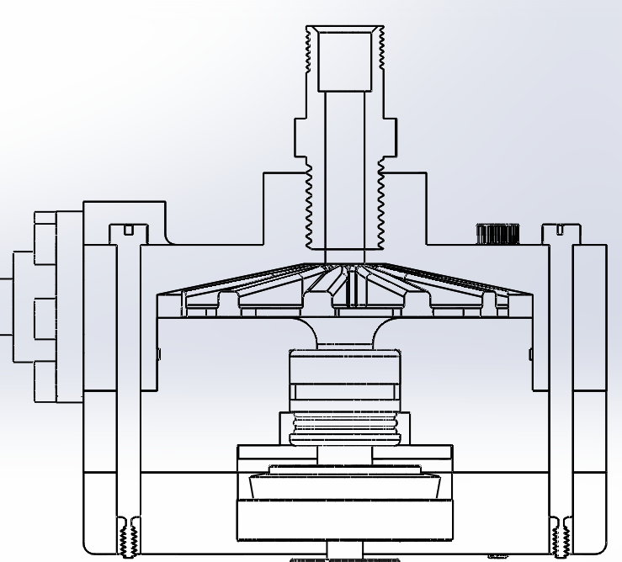
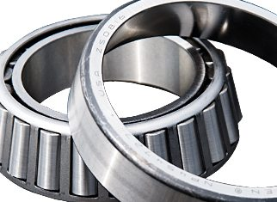
ELECTRIC FEED SYSTEM
PROGRESS ON DESIGN
IPA Pump: Final Design
Flowserve 0.5” ID Pac-Seal
Timken Tapered Roller Bearing

Slide 10
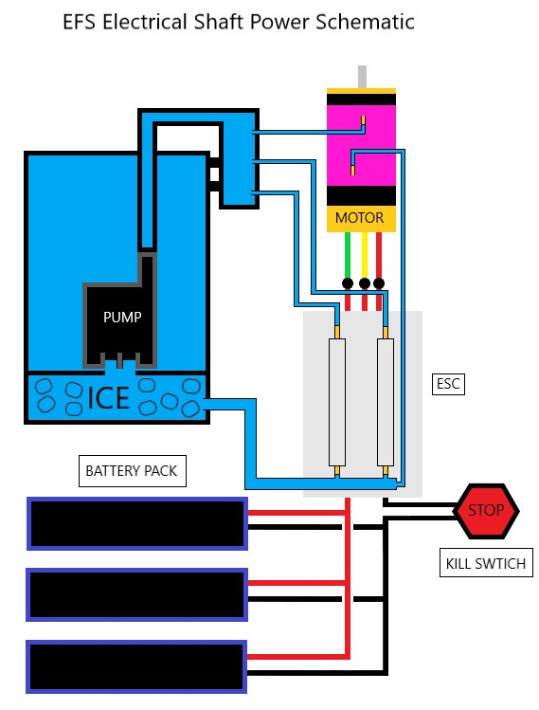
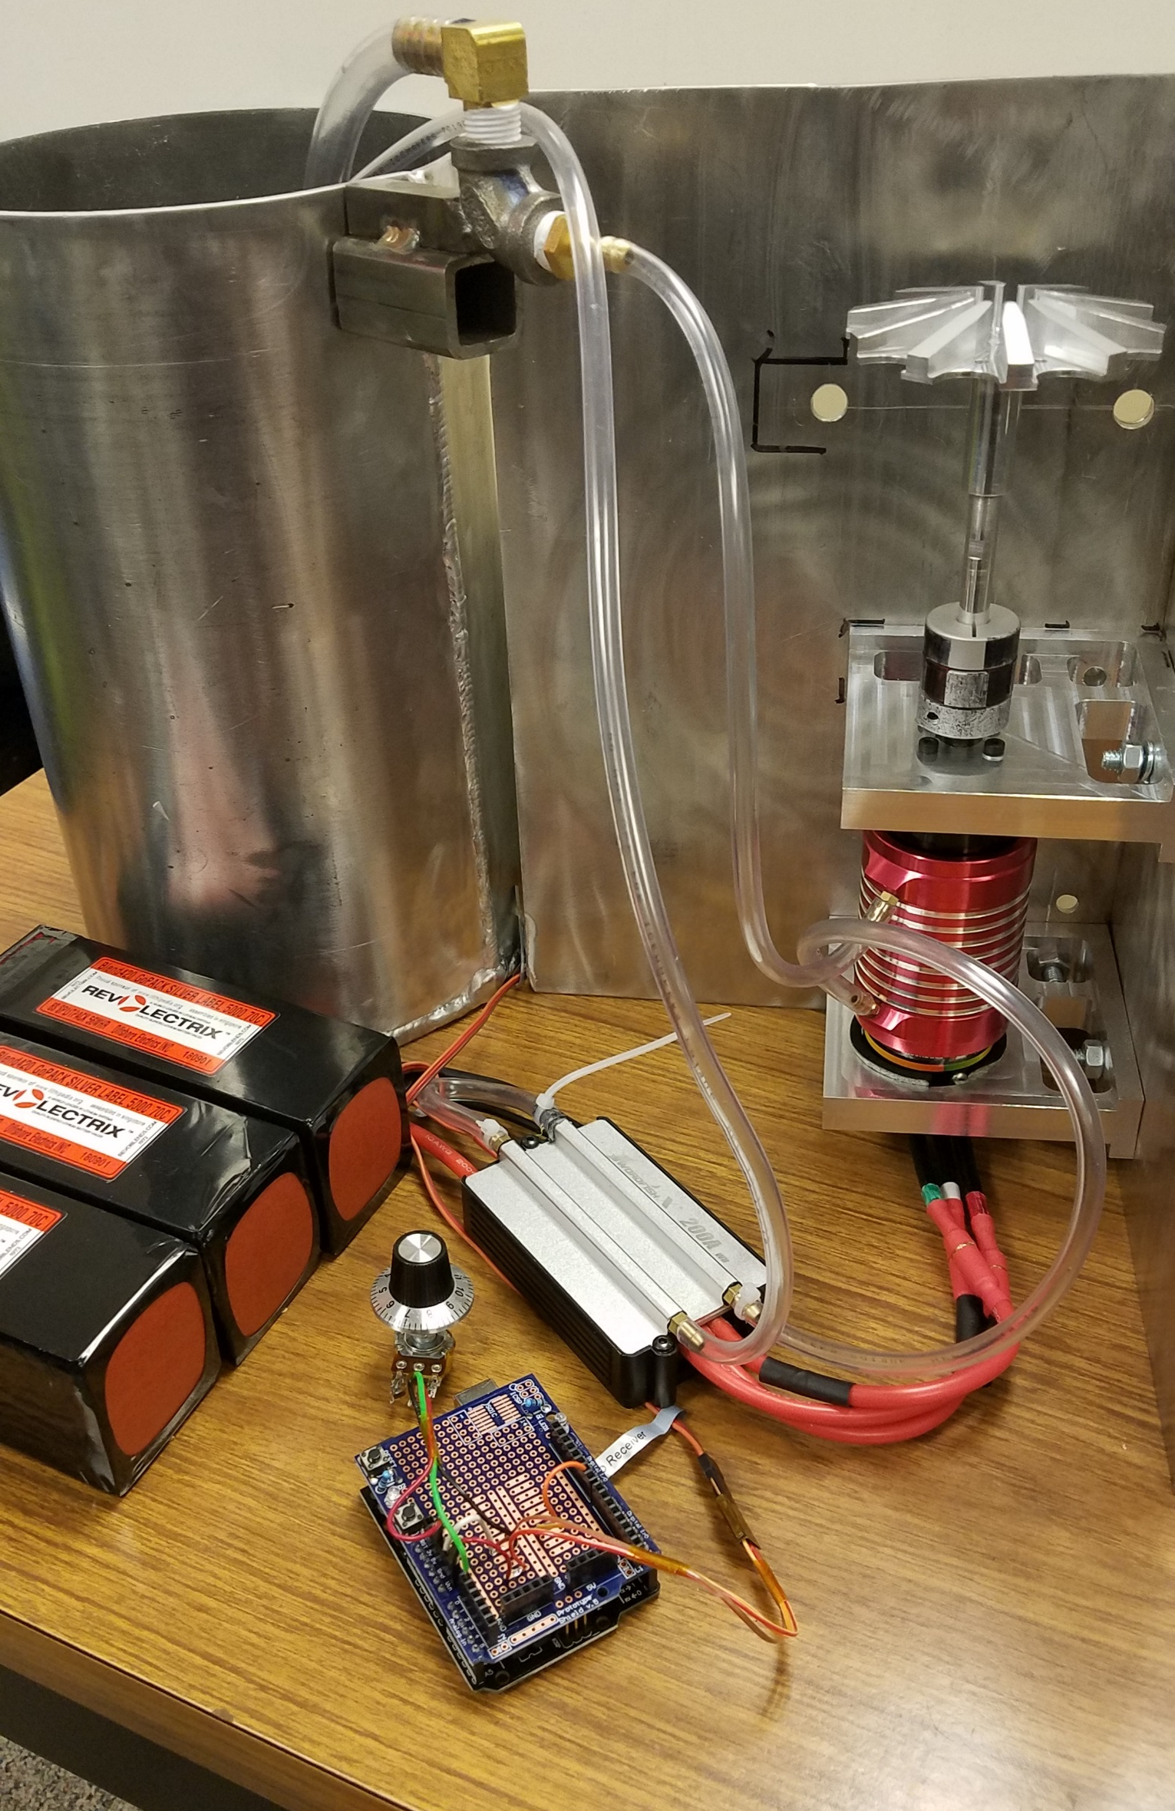
ELECTRIC FEED SYSTEM
SHAFT POWER COMPONENTS
TP POWER BLDC MOTOR
SWORDFISH ESC
REVLECTRIX LiPO BATTERIES
PROGRESS ON DESIGN

Slide 11
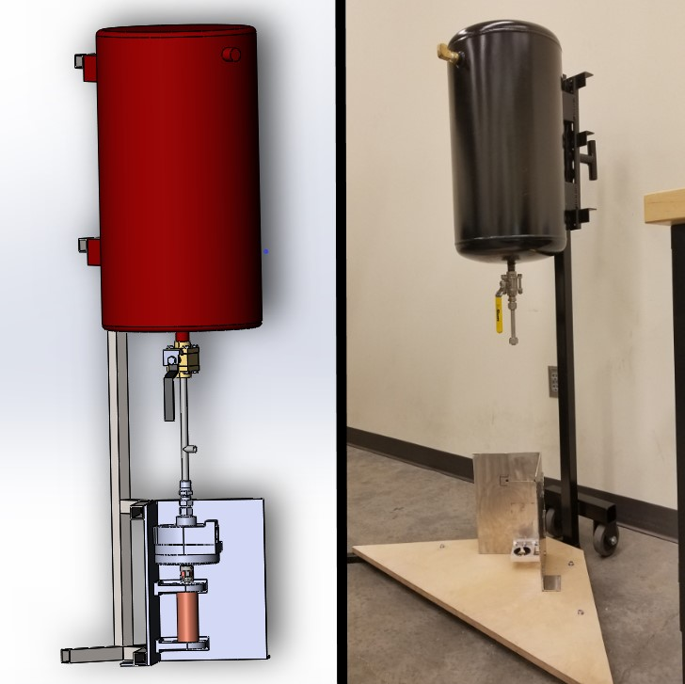
ELECTRIC FEED SYSTEM
TEST STAND
MOBILE STATION
STEEL CONSTRUCTION
DUAL PUMP COMPATIBLE
FUEL TANK
STEEL TANK
½” NPT CONNECTIONS
125 PSI MAX PRESSURE
PROGRESS ON DESIGN

Slide 12
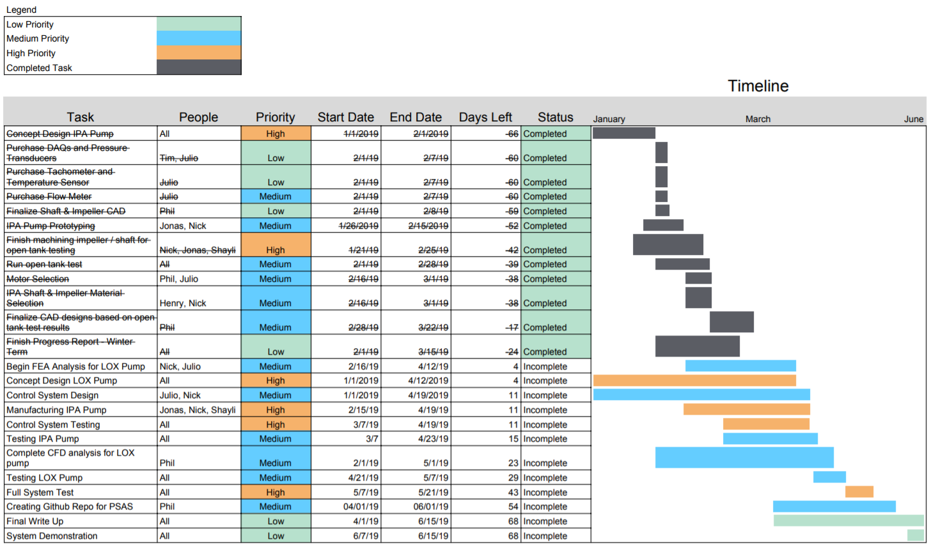
ELECTRIC FEED SYSTEM
EFS Gantt Chart
Today

Slide 13
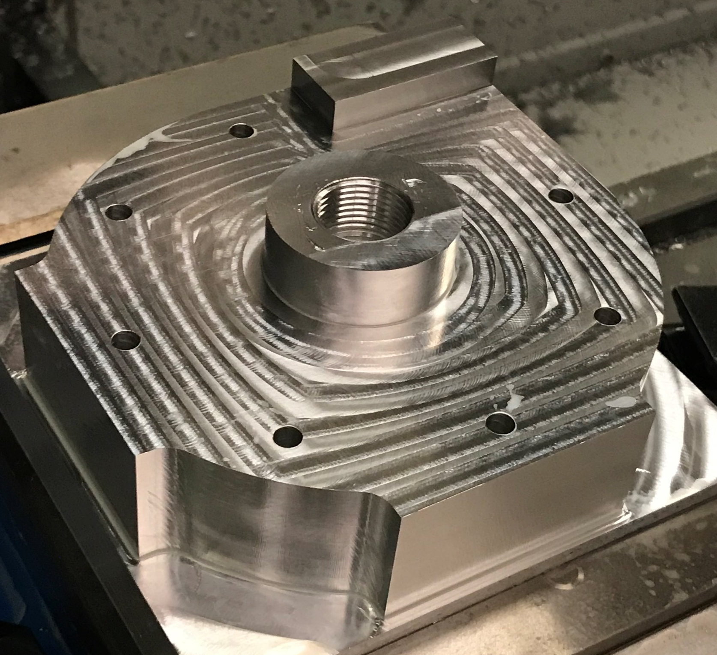
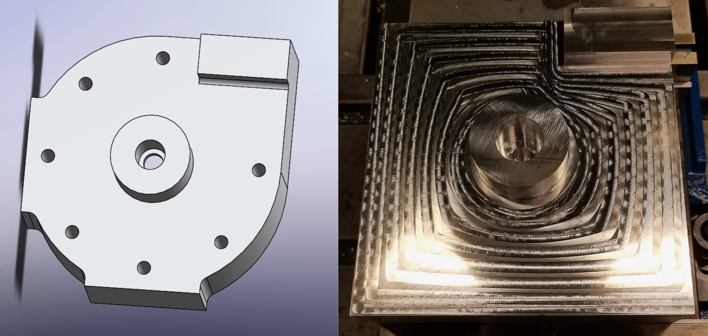
ELECTRIC FEED SYSTEM
Ongoing Projects
IPA CASE FINAL MANUFACTURING
Case_2 component. OP1 done, OP2 (backside – chamber ) toolpath ready.
Full case to be completed by 04/19/2019

Slide 14
ELECTRIC FEED SYSTEM
Ongoing Projects
Full Scale IPA Pump Testing
TARGET DATE
04/23/2019
GOALS
Determine peak pressure and flowrate performance
Record manual throttle position for autonomous feedback operation
Identify weakness in design for continual improvement in functionality

Slide 15
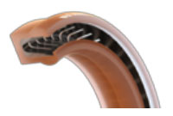
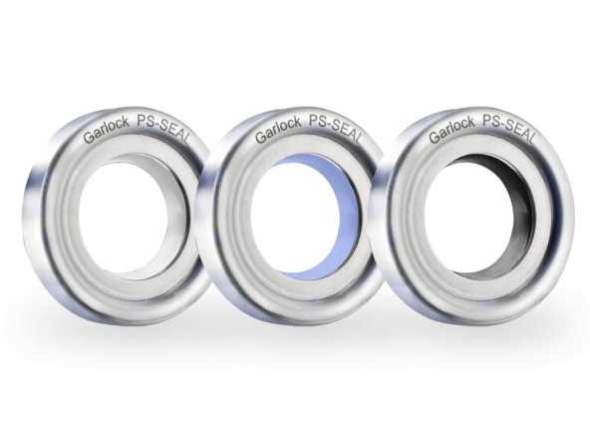
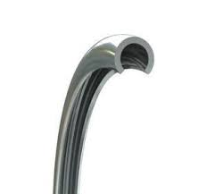
ELECTRIC FEED SYSTEM
Ongoing Projects
Cryogenic Pump Design Considerations: Seal Selection
For shaft seal . . .
Marco Spring Energized Double
Coil Seal
Garlock PS-Seal (PTFE)
C-Ring PTFE (Teflon) Energized
Spring Seal

Slide 16

ELECTRIC FEED SYSTEM
Ongoing Projects
Cryogenic Pump Design Considerations: Seal Selection
For pump chamber . . .
PTFE (Teflon) sheets between chamber cases
Must be replaced semi-often
Will only be used if leak found

Slide 17

ELECTRIC FEED SYSTEM
Ongoing Projects
Cryogenic Pump Design Considerations: Case Material Selection
Aluminum alloy will be used for Cryogenic (NO₂) case
Acceptable impact strength at low temps
Low cost
Easy to machine
Options: 6061, 5038-O, 7075
Different material may be required for LOX

Slide 18
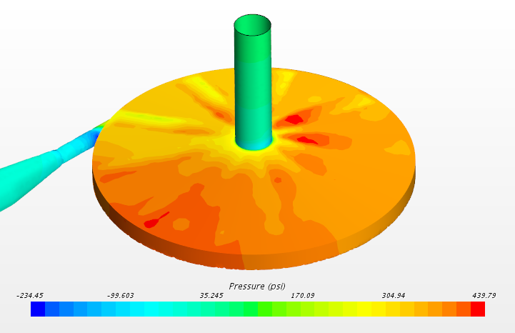
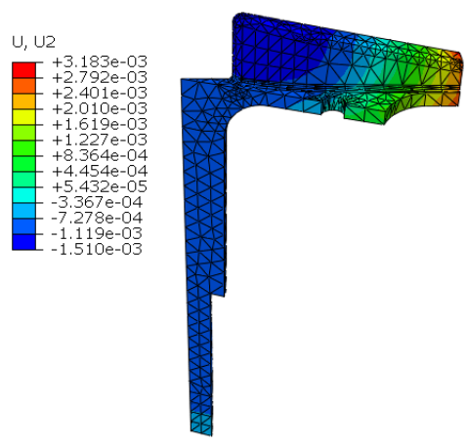
ELECTRIC FEED SYSTEM
Ongoing Projects
Cryogenic Pump Design Considerations: Simulations
CFD: Pump Chamber Pressure
FEA: Radial Impeller Deformation
Both works in progress
Shown promising results so far

Slide 19
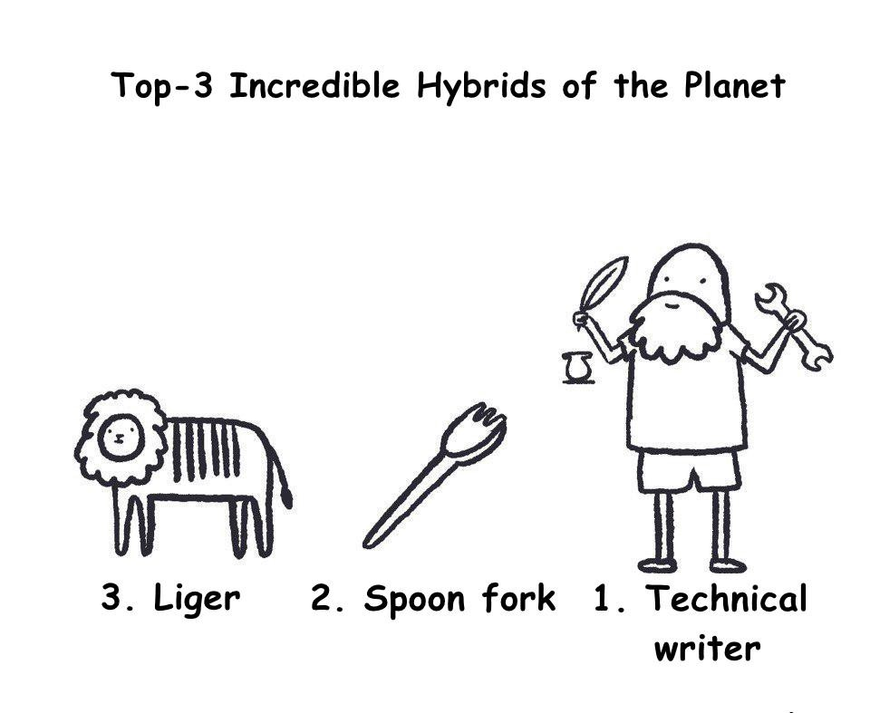
ELECTRIC FEED SYSTEM
TECHNICAL WRITING
FEEDBACK
DESCRIPTIVE FIGURE CAPTIONS
SCALE COMPONENT IMAGES
LABEL PARTS IN DRAWINGS
DISCUSS RISK FACTORS ASSOCIATED WITH COMPONENTS

Slide 20

ELECTRIC FEED SYSTEM
CONCLUSION
Creating Electric Feed System for PSAS
Full Scale IPA Pump Testing this Month
Cryogenic Pump Design being Finalized

